Slide 1
SG ALLIED BUSINESSES LIMITED
B-40, S.I.T.E, KARACHI, PAKISTAN

Slide 2
The company is currently engaged in following areas:
Cold Storage and Warehousing Facility.
Hydroponic growing of value added vegetables and Mushrooms.

Slide 3
An Investment of Rs. 105,763,713/- is made in new Hydroponic Facility for growing of Mushrooms and Inshaa Allah Production will start from January 2023, which will significantly increase Company’s Revenue and Profitability.

Slide 4
Vertical Farm is a new technology which is introduced for the First time in Pakistan and also Mushroom in Hydroponic is also our new Technology.
The Company is trying to find new areas where investment can be made and Profitability of the company can be increased.

Slide 5
However, there are many challenges because of uncertainty faced by every business and some of the challenges are as follows:
Restrictions in imports.
Difficulty in opening Letter of Credit for Raw Material as well as Spare Parts.
So these are the challenges which may effect the company’s future working.

Slide 6
VERTICAL FARM

Slide 7
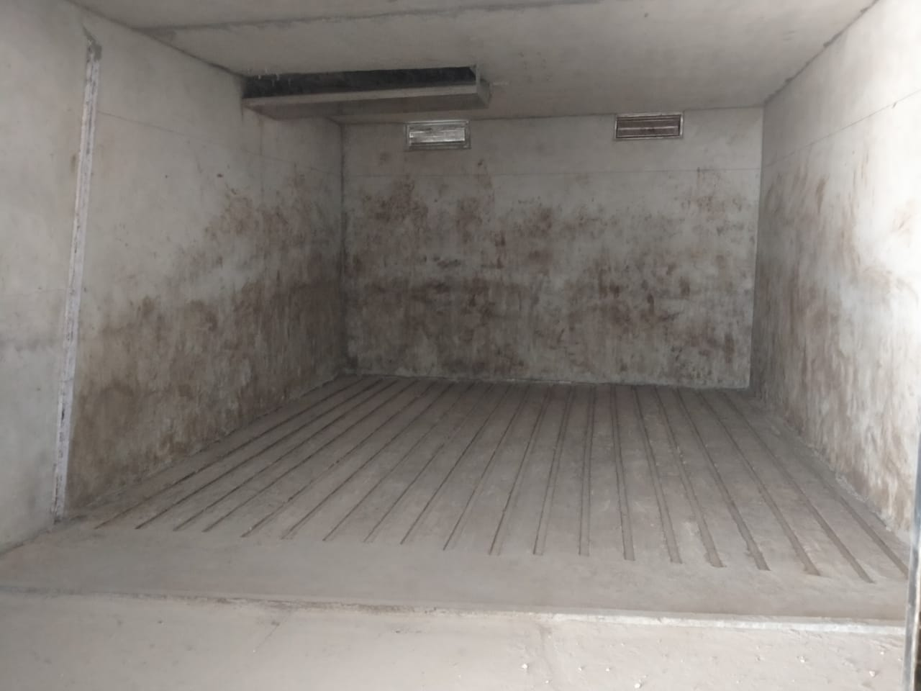
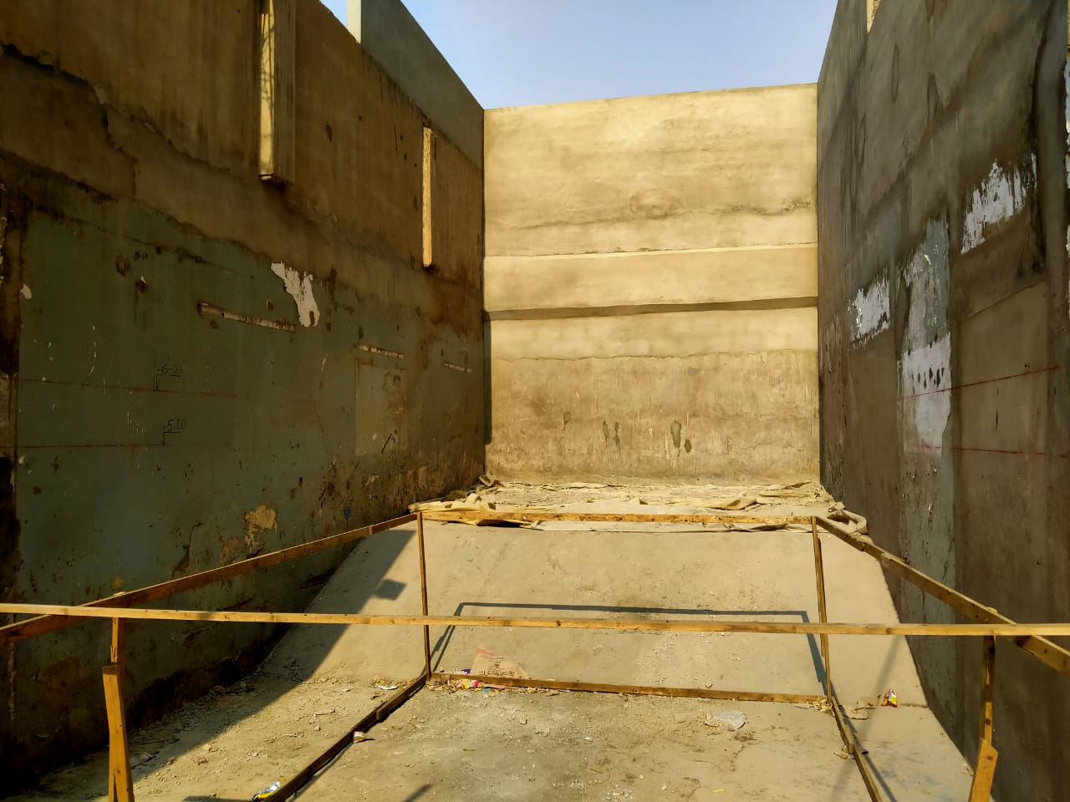
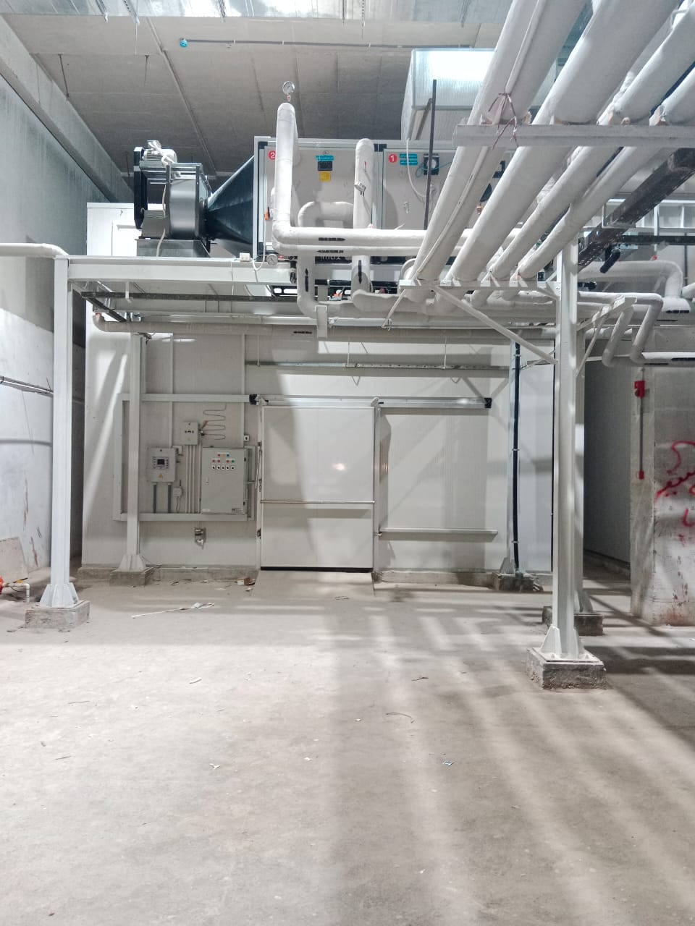
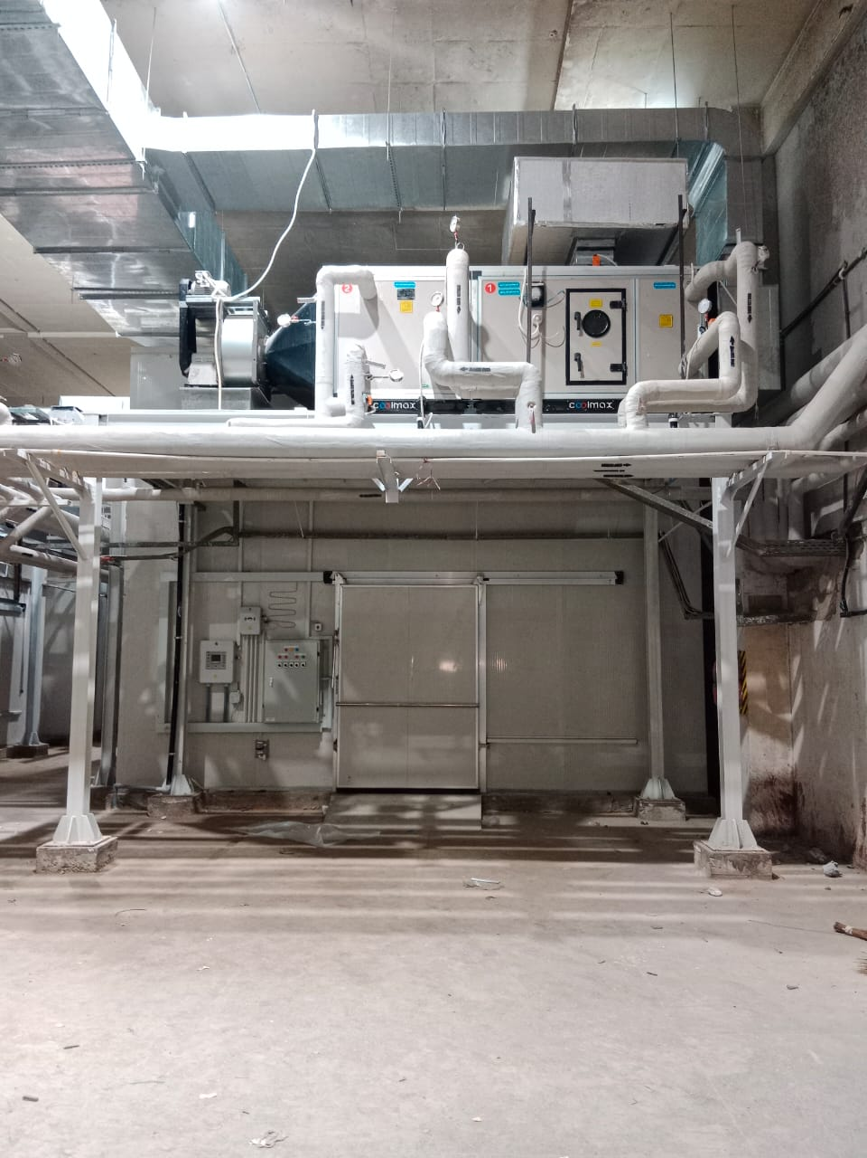
MUSHROOM PRODUCTION HYDROPONIC FACILITY

Slide 8
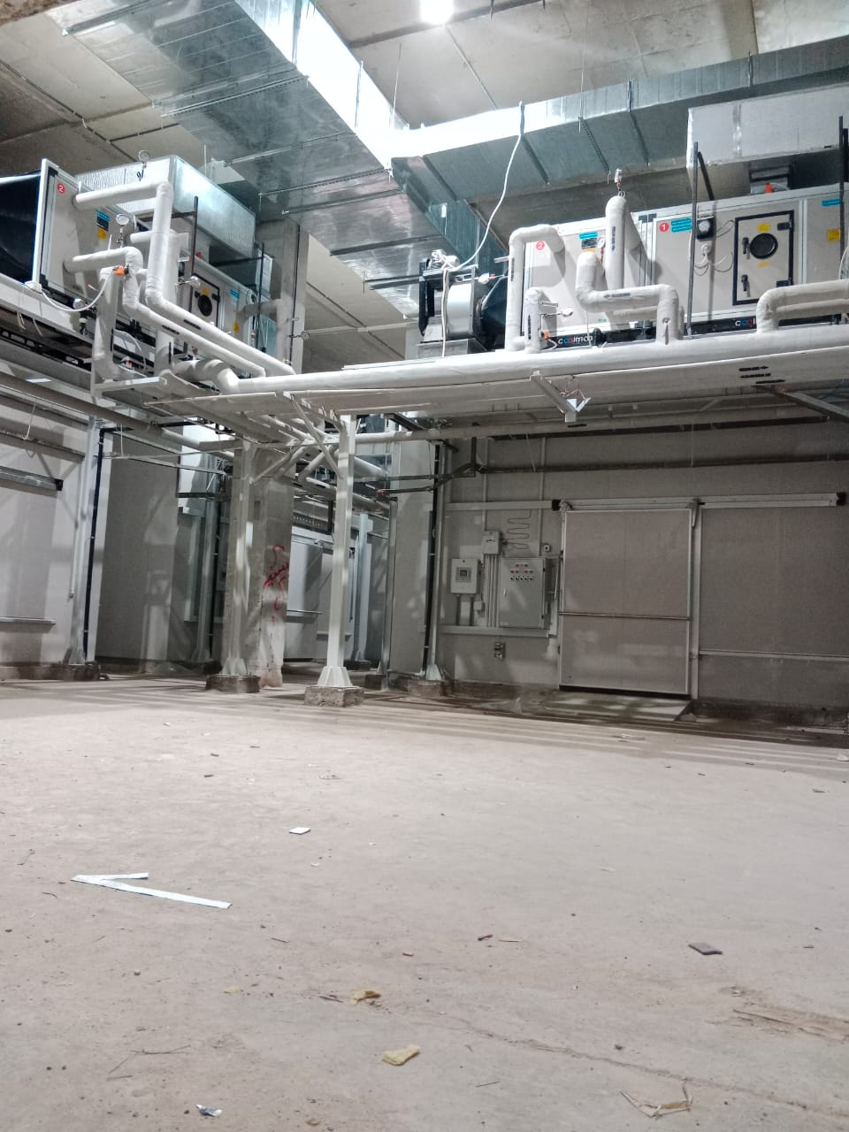
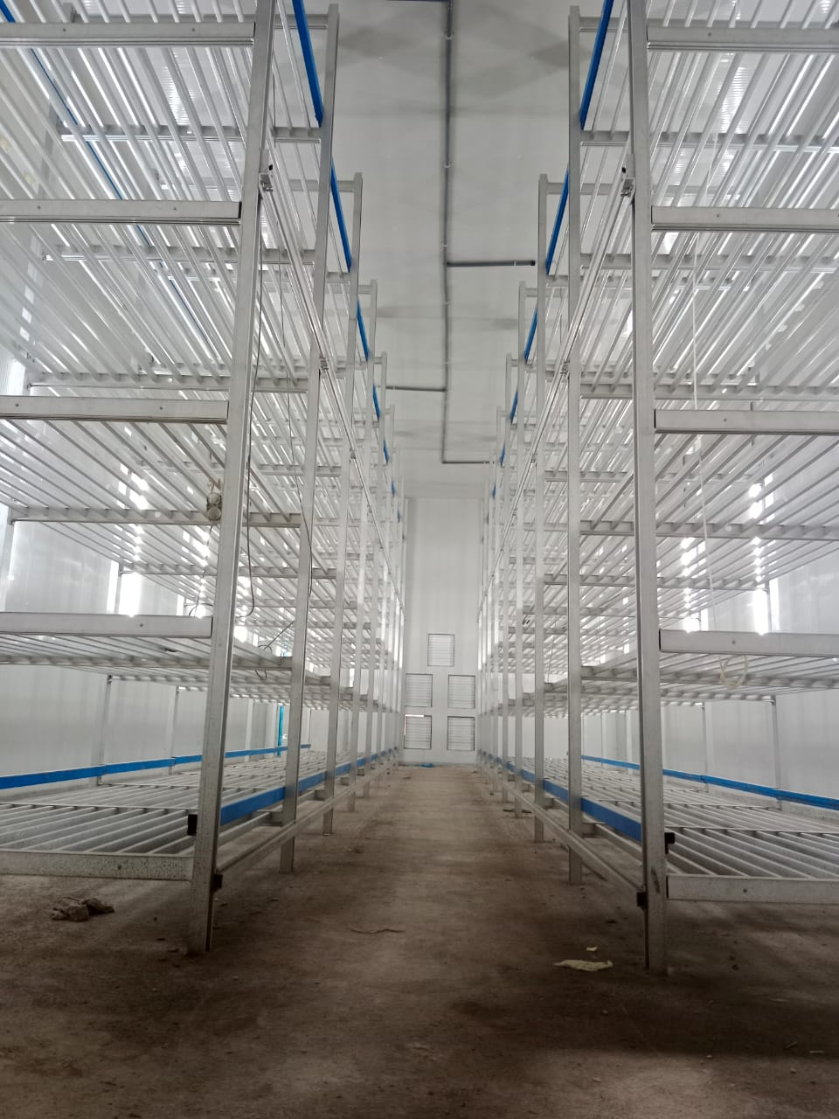
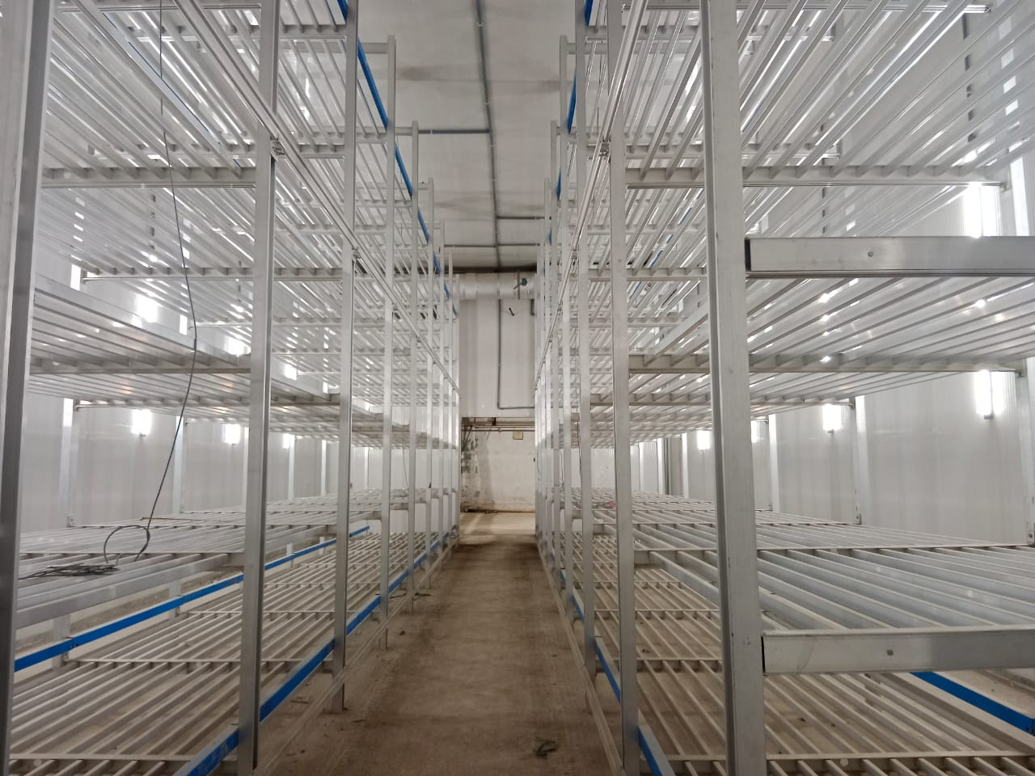
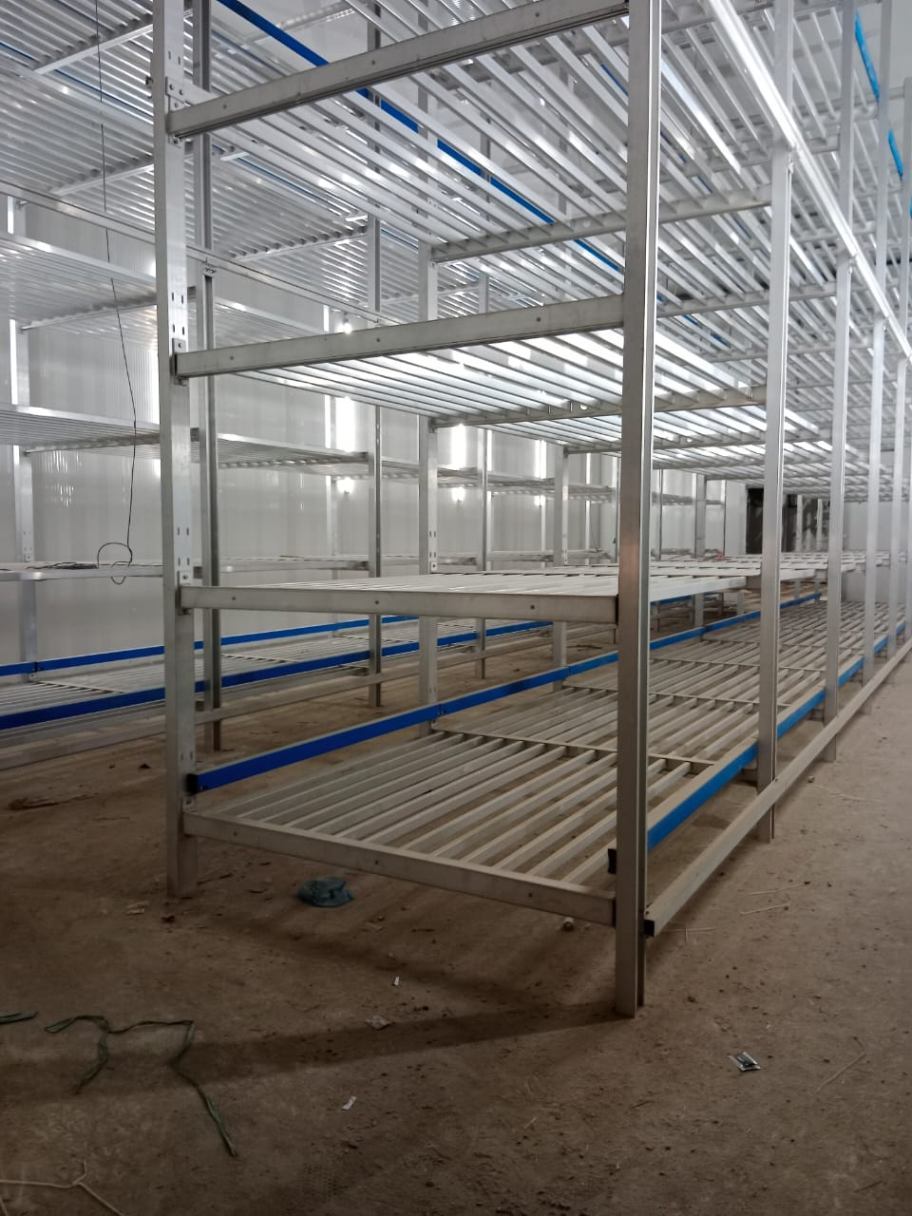
MUSHROOM PRODUCTION HYDROPONIC FACILITY

Slide 9
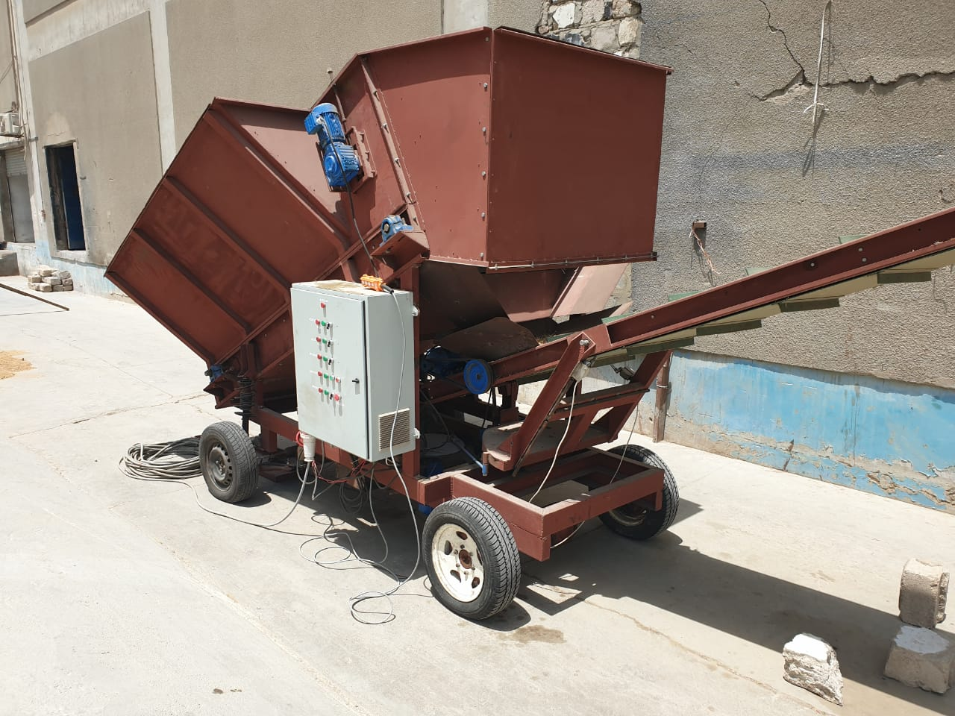
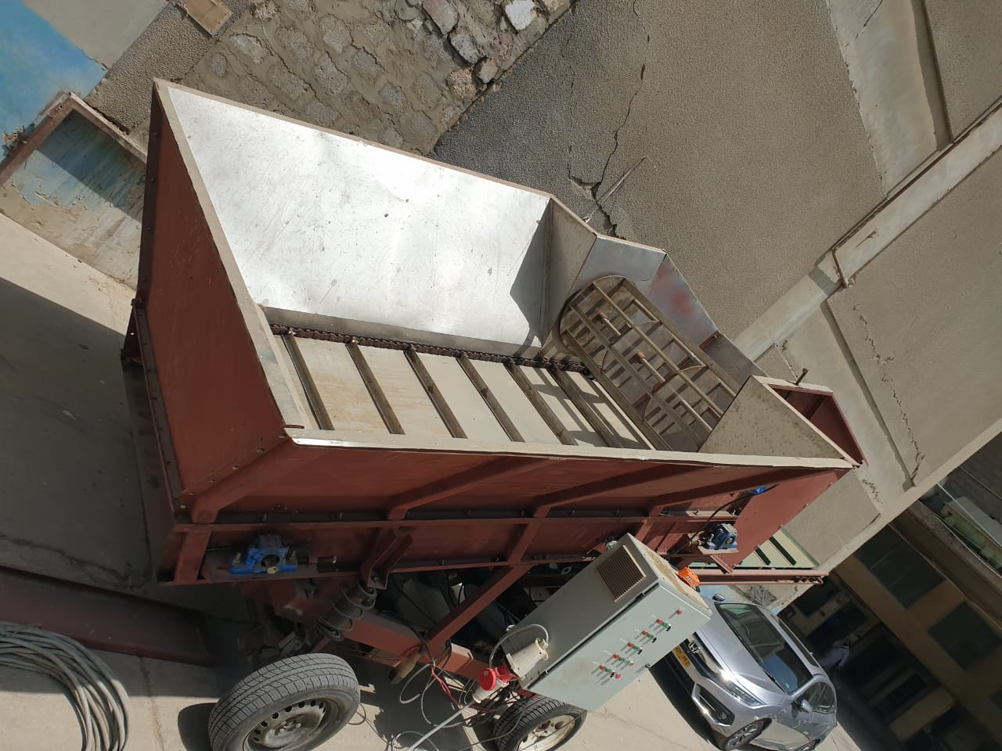
MUSHROOM PRODUCTION HYDROPONIC FACILITY(BUNKER FILLING MACHINE)

Slide 10
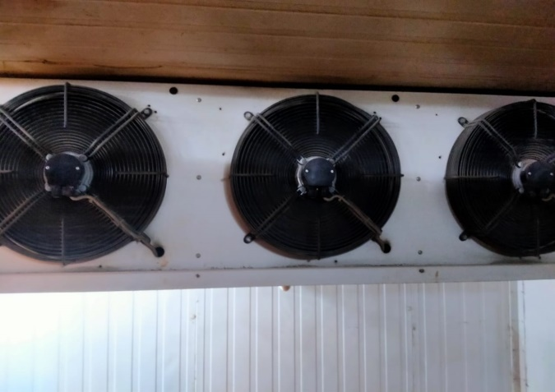
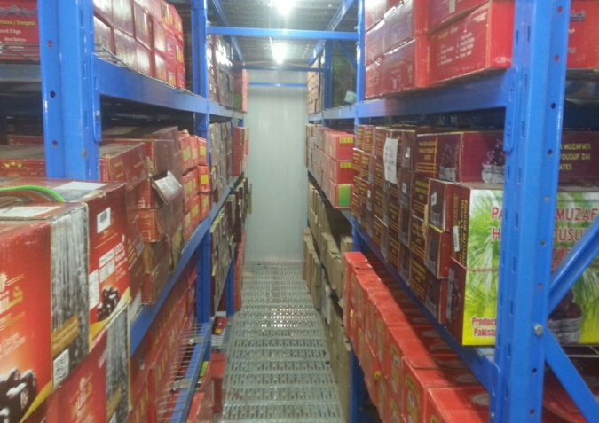
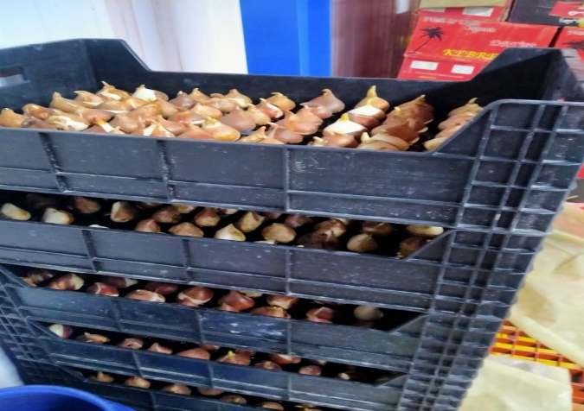
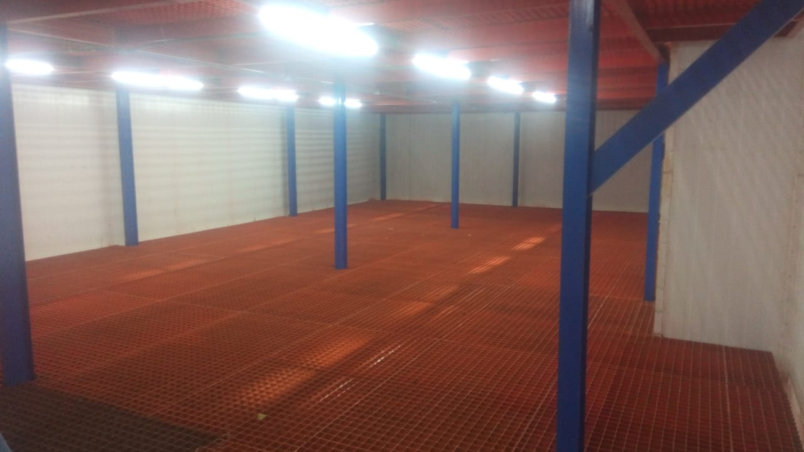
COLD STORE & WAREHOUSE

Slide 11
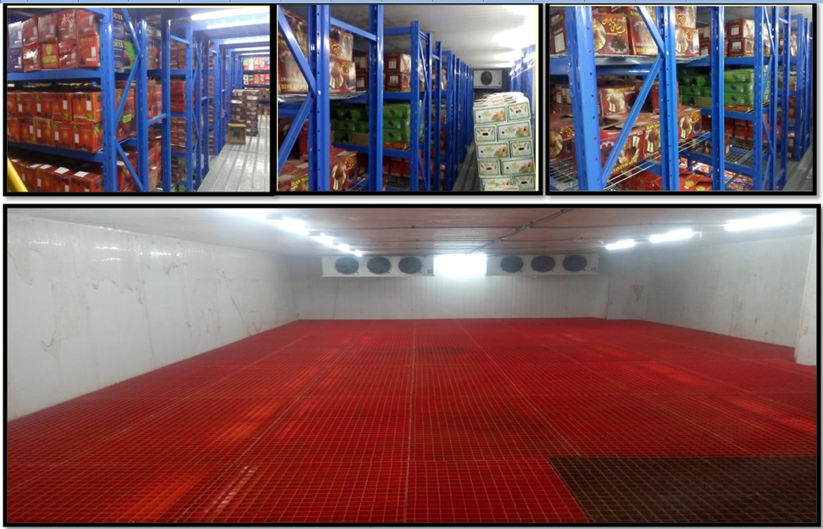

Slide 12
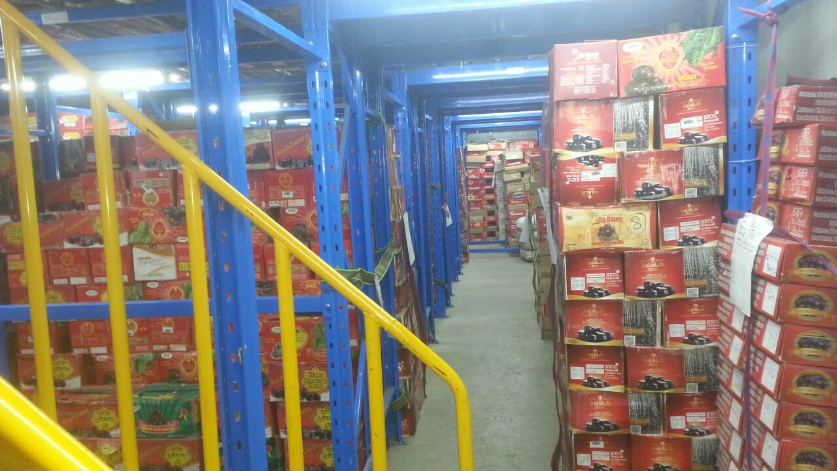
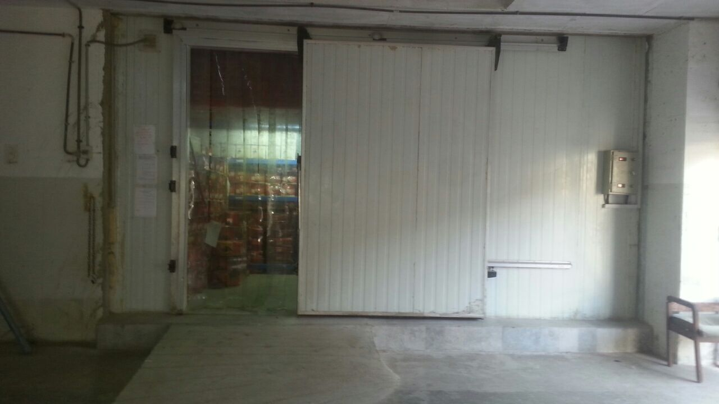
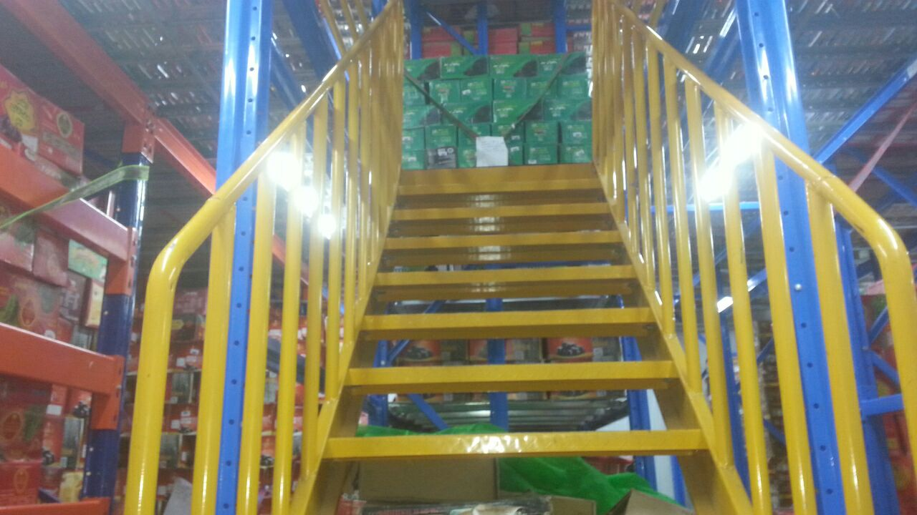
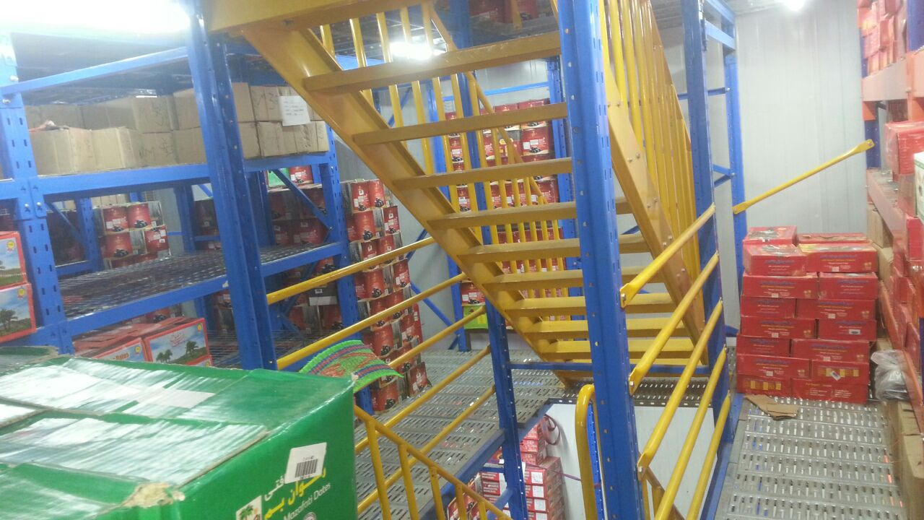

Slide 13
THANK YOU

